Slide 1
Lab 1

Slide 2
Purpose
To demonstrate
You have created a java development environment
You have correctly set up the IDE
You understand java syntax
You can call object methods
You understand packages
You understand how to use multiple classes
You can submit your labs and assignments remotely

Slide 3
Getting Started
Change the file templates so that all the files you create have your name and student number in them

Slide 4
Class Design
Your solution will consist of 2 classes - Lab1 and Player
Lab1 will be in the <student#> package and Player will be in the data sub-package

Slide 5
Player
Contains the following attributes
An identifier
First name
Last name
Email address
Gamer tag (think of it as a public alias)
the attributes must follow the java coding convention variable naming format
Has appropriate constructor(s)
Has eclipse generated getters and setters
Has an eclipse generated toString method

Slide 6
Lab1
 I know some of you know about collections, but please use arrays
Contains a constructor which takes an integer parameter “count”
Contains a main method which passes a value from the commandline to the Lab1 constructor
If a parameter is not entered on the commandline, a meaningful error message will be displayed and the program will exit
The constructor will create a players array large enough to hold exactly “count” elements and will then instantiate and add that number of players to the array
Each player will be the same and will contain information for all the attributes
Finally, the array will be printed to the console in a single System.out.println statement – NOT using a loop
see http://docs.oracle.com/javase/8/docs/api/java/util/Arrays.html

Slide 7

Sample Run
Running the program with no commandline arguments
An integer value must be passed to the program.
NOTE: Look in the Integer class to see how to convert from a string to an integer
Running the program with a valid commandline argument:
[Player [id=1, firstName=Fred, lastName=Fish, emailAddress=fredfish@gamer.net, gamerTag=Ithroeann], Player…

Slide 8
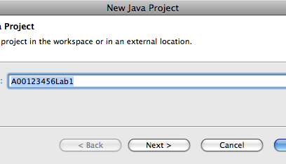
Project Name
Must be named [Student Number] + [Lab or Assignment Number]
e.g. A00123456Lab1

Slide 9
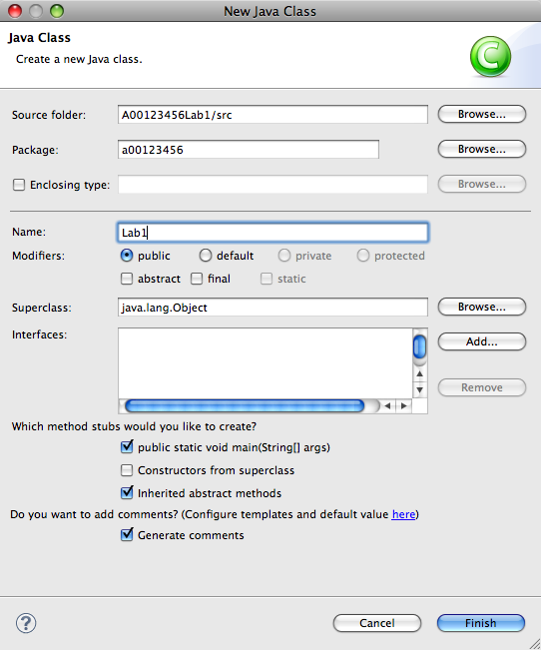
Main Class
Package:
Your student# (lowercase a00…)
Name:
Lab#
e.g. Lab1
Create main
Generate comments

Slide 10
Exiting an Application
To quit a program normally, use
System.exit(0);
abnormally:
System.exit(-1);

Slide 11
Build the Application
Make sure you change the file templates so that all the files you create have your name and student number in them
Create and test the program using eclipse

Slide 12


Submit Your Solution
Create a zip file of your solution, ex. A00123456Lab1.zip
Include ALL your project files, including the jar file
Submit your zip file to http://learn.bcit.ca in the DropBox before the due date & time
Don’t wait until the last minute!

Slide 13
Assignments and Labs
Must be completed individually
Must be handed in before the due date and time
Labs and assignments that are not in the drop box at the time due will not be marked
Must meet all the requirements
Jar file MUST always be submitted - except week 1
ALL project files must be submitted
Code MUST be correctly formatted (Source > Format) and must adhere to the java coding conventions

Slide 14

Checklist
I have:
Met all the functional requirements
Followed the java coding conventions
Used a file template to add my name & student number to all source files
Used packages; the base package is my student number, ex. package a00123456.labs…;
Used great object-oriented design
Run “Source > Format” on my project
Included all source code & required resources
Zipped up all my files into a single file named <your student number>.zip, ex. A00123456.zip
Submitted my lab before the due date & time

